Slide 1

Natural Language Processing (NLP)
Concepts, Techniques, and Transformer-Based Modern NLP
Harsh Dalal

Slide 2

Agenda
What is NLP
  NLP Tasks: Syntax vs Semantics
  Basic NLP Syntax & Text Processing
Applications of NLP
Text Cleaning Techniques
  Handling Missing / Noisy Data
  Text Normalization
Vectorization Techniques
  BoW & TF-IDF
Word Embeddings: Word2Vec & GloVe
Attention & Self-Attention
Transformer Architecture
  BERT
  GPT
Summary

Slide 3

What is NLP
NLP is a field of AI that enables computers to understand, interpret, process, and generate human language.
Combines:
Linguistics → rules of grammar & meaning
Machine Learning → learning patterns from data
Deep Learning → neural language understanding
Used for communication, knowledge retrieval, automation, language understanding.

Slide 4
Why NLP is Challenging
Ambiguity in language
Multiple meanings of words (“bank,” “bat,” “light”)
Context dependency
Sarcasm & emotion
No fixed grammar in real-world English
Slang, emojis, typos in text
Long-range dependencies in sentences

Slide 5
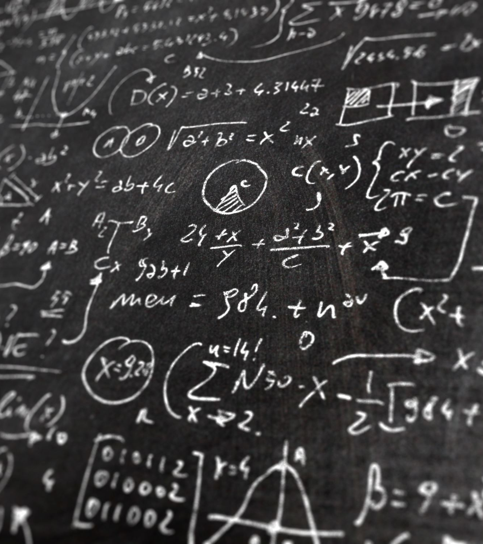
NLP Tasks: Syntax & Semantics
1. Syntax Tasks (Structure)
  Tokenization
    Splitting text into smaller units such as words, subwords, or sentences.
  POS Tagging
    Assigning grammatical roles (noun, verb, adjective, etc.) to each word.
  Parsing (Dependency & Constituency)
    Analyzing grammatical structure to show how words relate (dependency) or form phrases (constituency).
  Chunking
    Grouping tagged words into meaningful phrase-level chunks like noun or verb phrases.
  Syntactic Tree Construction
    Building a tree diagram that visually represents the complete grammatical structure of a sentence.

Slide 6

NLP Tasks: Syntax & Semantics
2. Semantics Tasks (Meaning)
  Named Entity Recognition (NER)
    Identifies and labels real-world entities in text such as names, locations, dates, and organizations.
  Sentiment Analysis
    Determines the emotional tone or opinion expressed in text (positive, negative, neutral).
  Semantic Similarity
    Measures how similar two pieces of text are in meaning, not just wording.
  Word Sense Disambiguation
    Determines the correct meaning of a word when it has multiple senses based on context.
  Question-Answering
    Automatically answers user questions using understanding and retrieval of text.
  Text Classification
    Assigns predefined categories to text, such as spam detection, topic labeling, or intent detection.

Slide 7

Basic NLP Syntax & Text Processing
Word Tokenization
Breaking text into individual words or subwords for processing.
Sentence Tokenization
Splitting a paragraph or document into individual sentences.
Removing Stopwords
Eliminating common words (like the, is, of) that add little meaning.
Stemming & Lemmatization
Reducing words to their root form to normalize variations (run, running → run).
POS Tagging
Assigning grammatical labels (noun, verb, adjective) to each word in a sentence.
N-grams
Creating sequences of N consecutive words to capture local context.
Chunking
Grouping words into meaningful phrases (like noun phrases or verb phrases).
Shallow Parsing
Extracting high-level sentence structure without full grammatical parsing.

Slide 8
Techniques for Cleaning Text Data
Lowercasing
Removing punctuation
Removing numbers (optional)
Removing stopwords
Removing URLs, hashtags, mentions
Removing emojis (or mapping them to emotions)
Spelling correction
Removing repeated characters (“goooood” → “good”)

Slide 9

Handling Missing or Noisy Data
Drop missing text rows
Use <UNK> token for unknown words
Back-off with synonyms
Spell correction
Use domain dictionaries
Normalize slang (“u” → “you”)
Remove extremely short texts (“ok”, “yes”)

Slide 10

Text Normalization
Lowercasing
Stemming: reduces word to rough root
Lemmatization: reduces word to dictionary base
Removing diacritics: “café → cafe”
Expanding contractions: “don’t → do not”

Slide 11
Vectorization Techniques
One-Hot Encoding
  Bag-of-Words (BoW)
  TF-IDF
Word Embeddings
  Word2Vec
  GloVe
Contextual Embeddings
  BERT
  GPT
  Transformers

Slide 12
Bag-of-Words (BoW)
Creates vocabulary from corpus
Represents text as word count vectors
Simple & fast
Issues:
Sparse vectors
No context
No word meaning

Slide 13
TF-IDF
TF = Term Frequency
IDF = How rare a word is across documents
Gives higher weight to important words
Reduces weight for common words (the, is)
Still context-free

Slide 14
Word Embeddings (Dense Vectors)
Maps words → dense numeric vectors
Words with similar meaning have similar vectors
Captures:
  Semantic meaning
  Relationships (king - man + woman ≈ queen)
  Word similarity

Slide 15
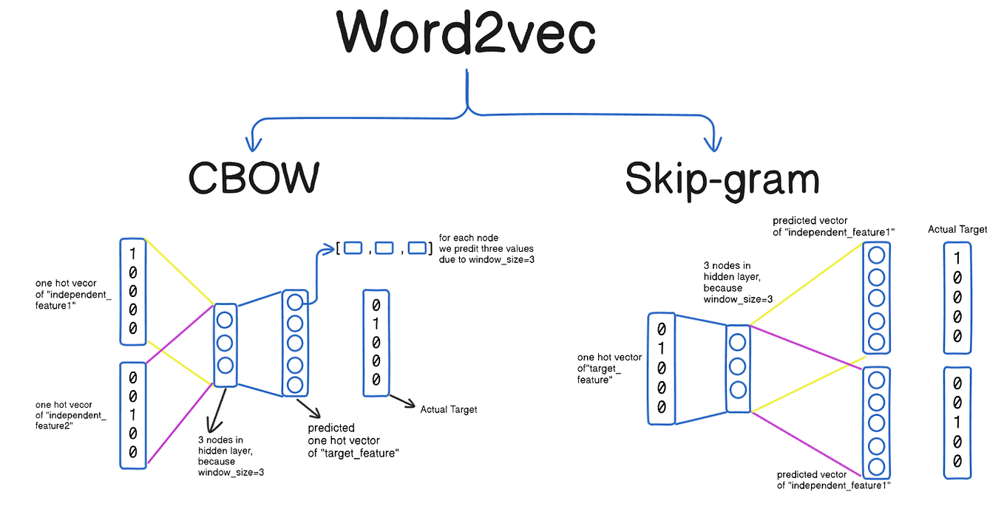
Word2Vec
Architecture
CBOW (predict target word from context)
Skip-gram (predict context from target word)
Key Features
Learns continuous vector representations
Captures semantic relationships
Uses shallow neural networks

Slide 16

GloVe (Global Vectors)
Based on global word co-occurrence statistics
Captures both local + global word meaning
Example: "ice" closer to “cold”, “winter” than “fire”

Slide 17
Attention Mechanism
Helps model focus on important words in a sequence
Assigns attention weights
Overcomes long-distance dependency issues in RNN/LSTM
Example:
Sentence: “The cat sat on the mat”
When predicting “sat”, attention focuses on “cat” and “mat”

Slide 18
Self-Attention
Each word attends to all other words in the sequence
Key idea behind transformers
Benefits:
Parallel computation
Captures global relationships
Enables long-range reasoning

Slide 19
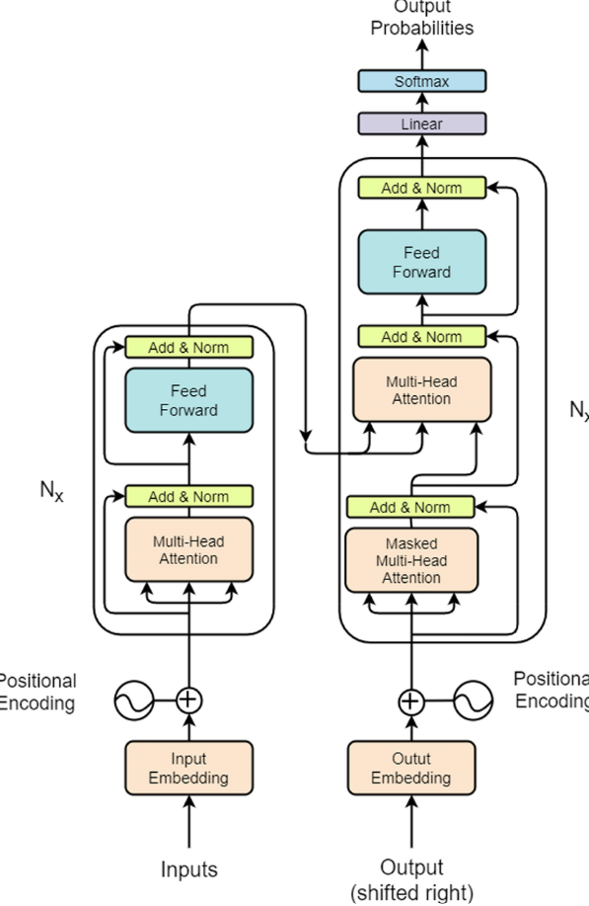
Transformer Architecture
Components
Multi-head self-attention
Positional encoding
Feed-forward layers
Layer normalization
Encoder & decoder stacks
Why it changed NLP
Fast (parallel)
Handles long sequences
Forms foundation for LLMs

Slide 20
BERT
Bidirectional Encoder Representations from Transformers
Only Encoder stack
Understands full left + right context
Tasks:
  Classification
  NER
  Q/A
  Semantic similarity
  Training Tasks:
Masked Language Modeling (MLM)
Next Sentence Prediction (NSP)

Slide 21
GPT
Generative Pretrained Transformer
Only Decoder stack
Autoregressive (predicts next token)
Excels in:
  Text generation
  Reasoning
  Summarization
  Chatbots
  Code generation

Slide 22
BERT vs GPT Comparison
Feature | BERT | GPT
Architecture | Encoder-only | Decoder-only
Training | Masked LM | Next-token prediction
Direction | Bidirectional | Unidirectional
Strength | Understanding | Generating
Best for | NLU tasks | Chatbots, writing, GenAI

Slide 23

Summary
NLP enables machines to work with human language
Text cleaning + normalization → better models
Vectorization evolved from BoW → TF-IDF → Embeddings
Word2Vec & GloVe improved semantics
Transformers revolutionized NLP
BERT = understanding, GPT = generation
Modern AI = Transformers + Attention + Large-scale pretraining

Slide 24

Any question

Slide 25

Thank you

